Slide 1
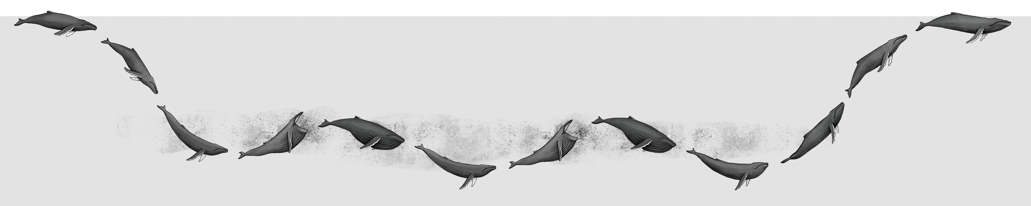
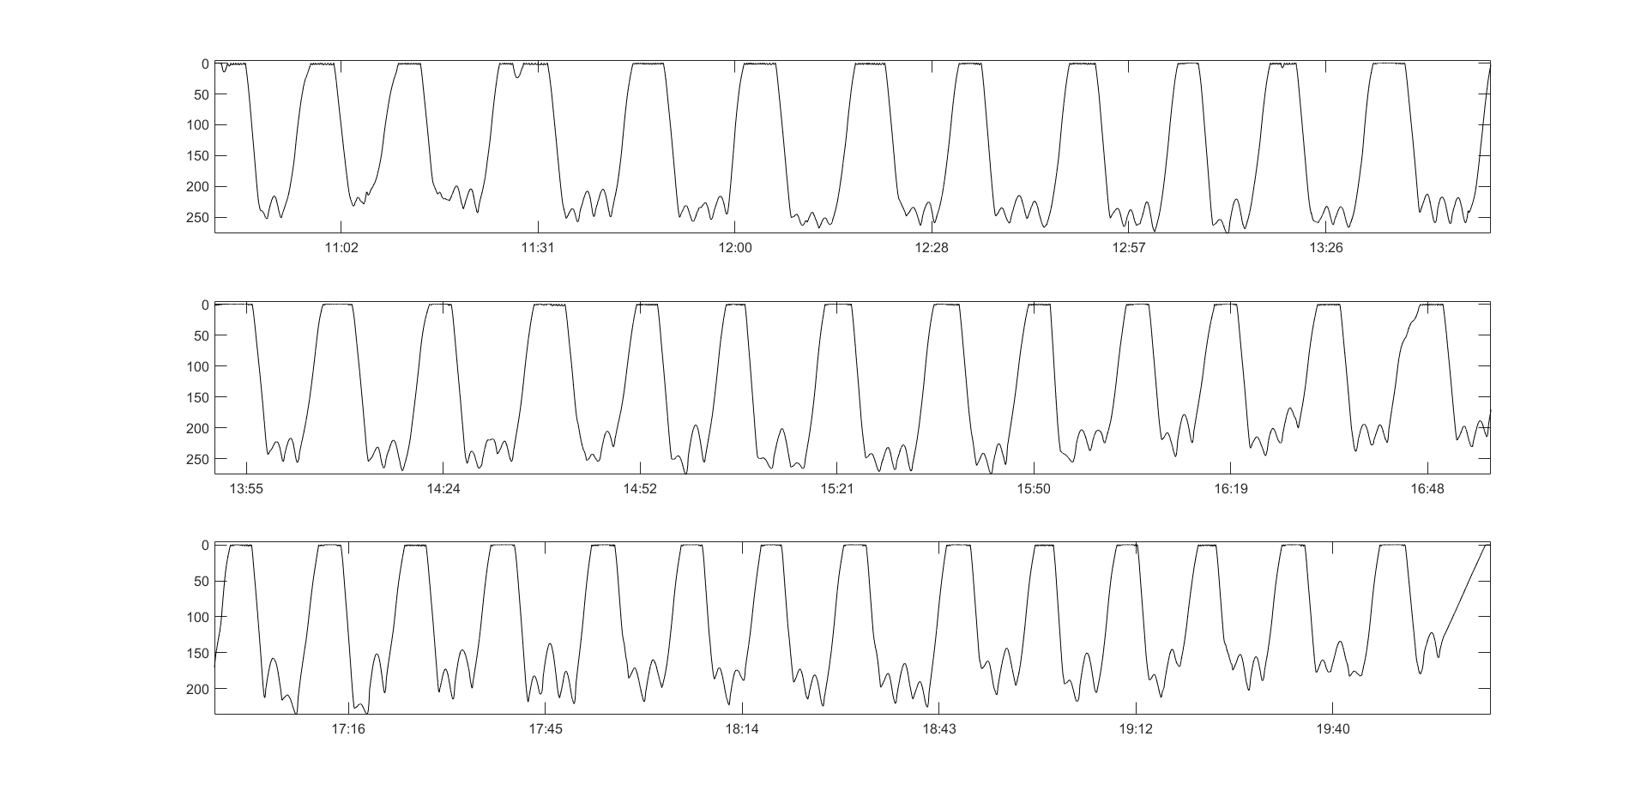
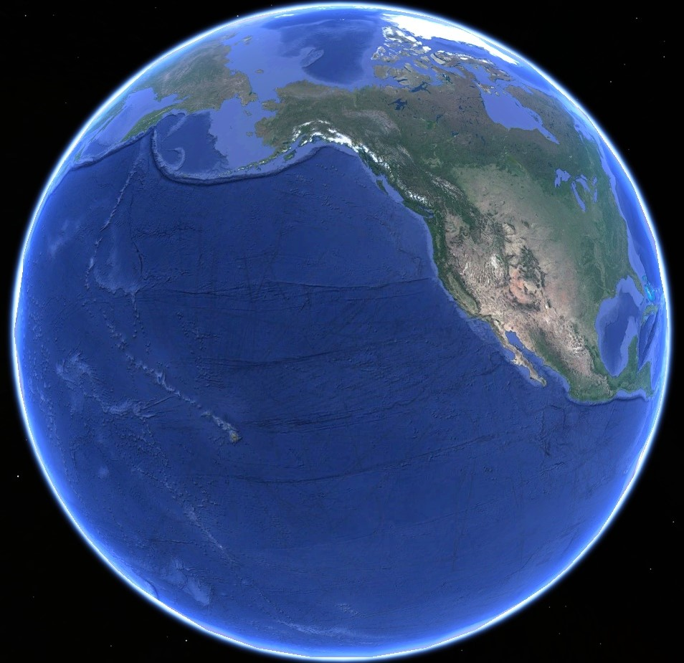
Lunging Kinematics
Metabolic Rate
Net Energy Gain
Net Energy Loss
Swimming Kinematics
Prey Density
Equatorward
Migration
~30-90 days
Lunge / Filtration Timing
Foraging Day Energetics
Daily Lunging Rates
Foraging Ground
~120-200 days
Breeding Ground
~30-120 days
Foraging Ground
Poleward
Migration
~30-90 days
~4500 km
Hawaii – Alaska
Net Energy Loss
Breeding Ground

Slide 2
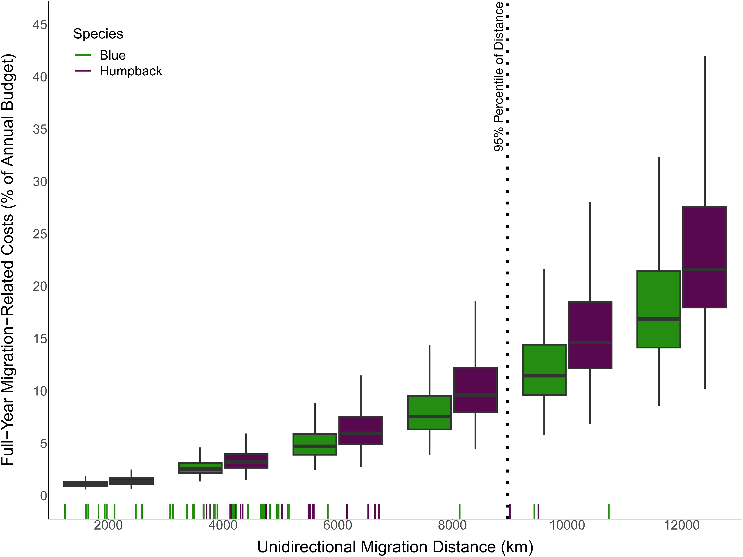

Slide 3
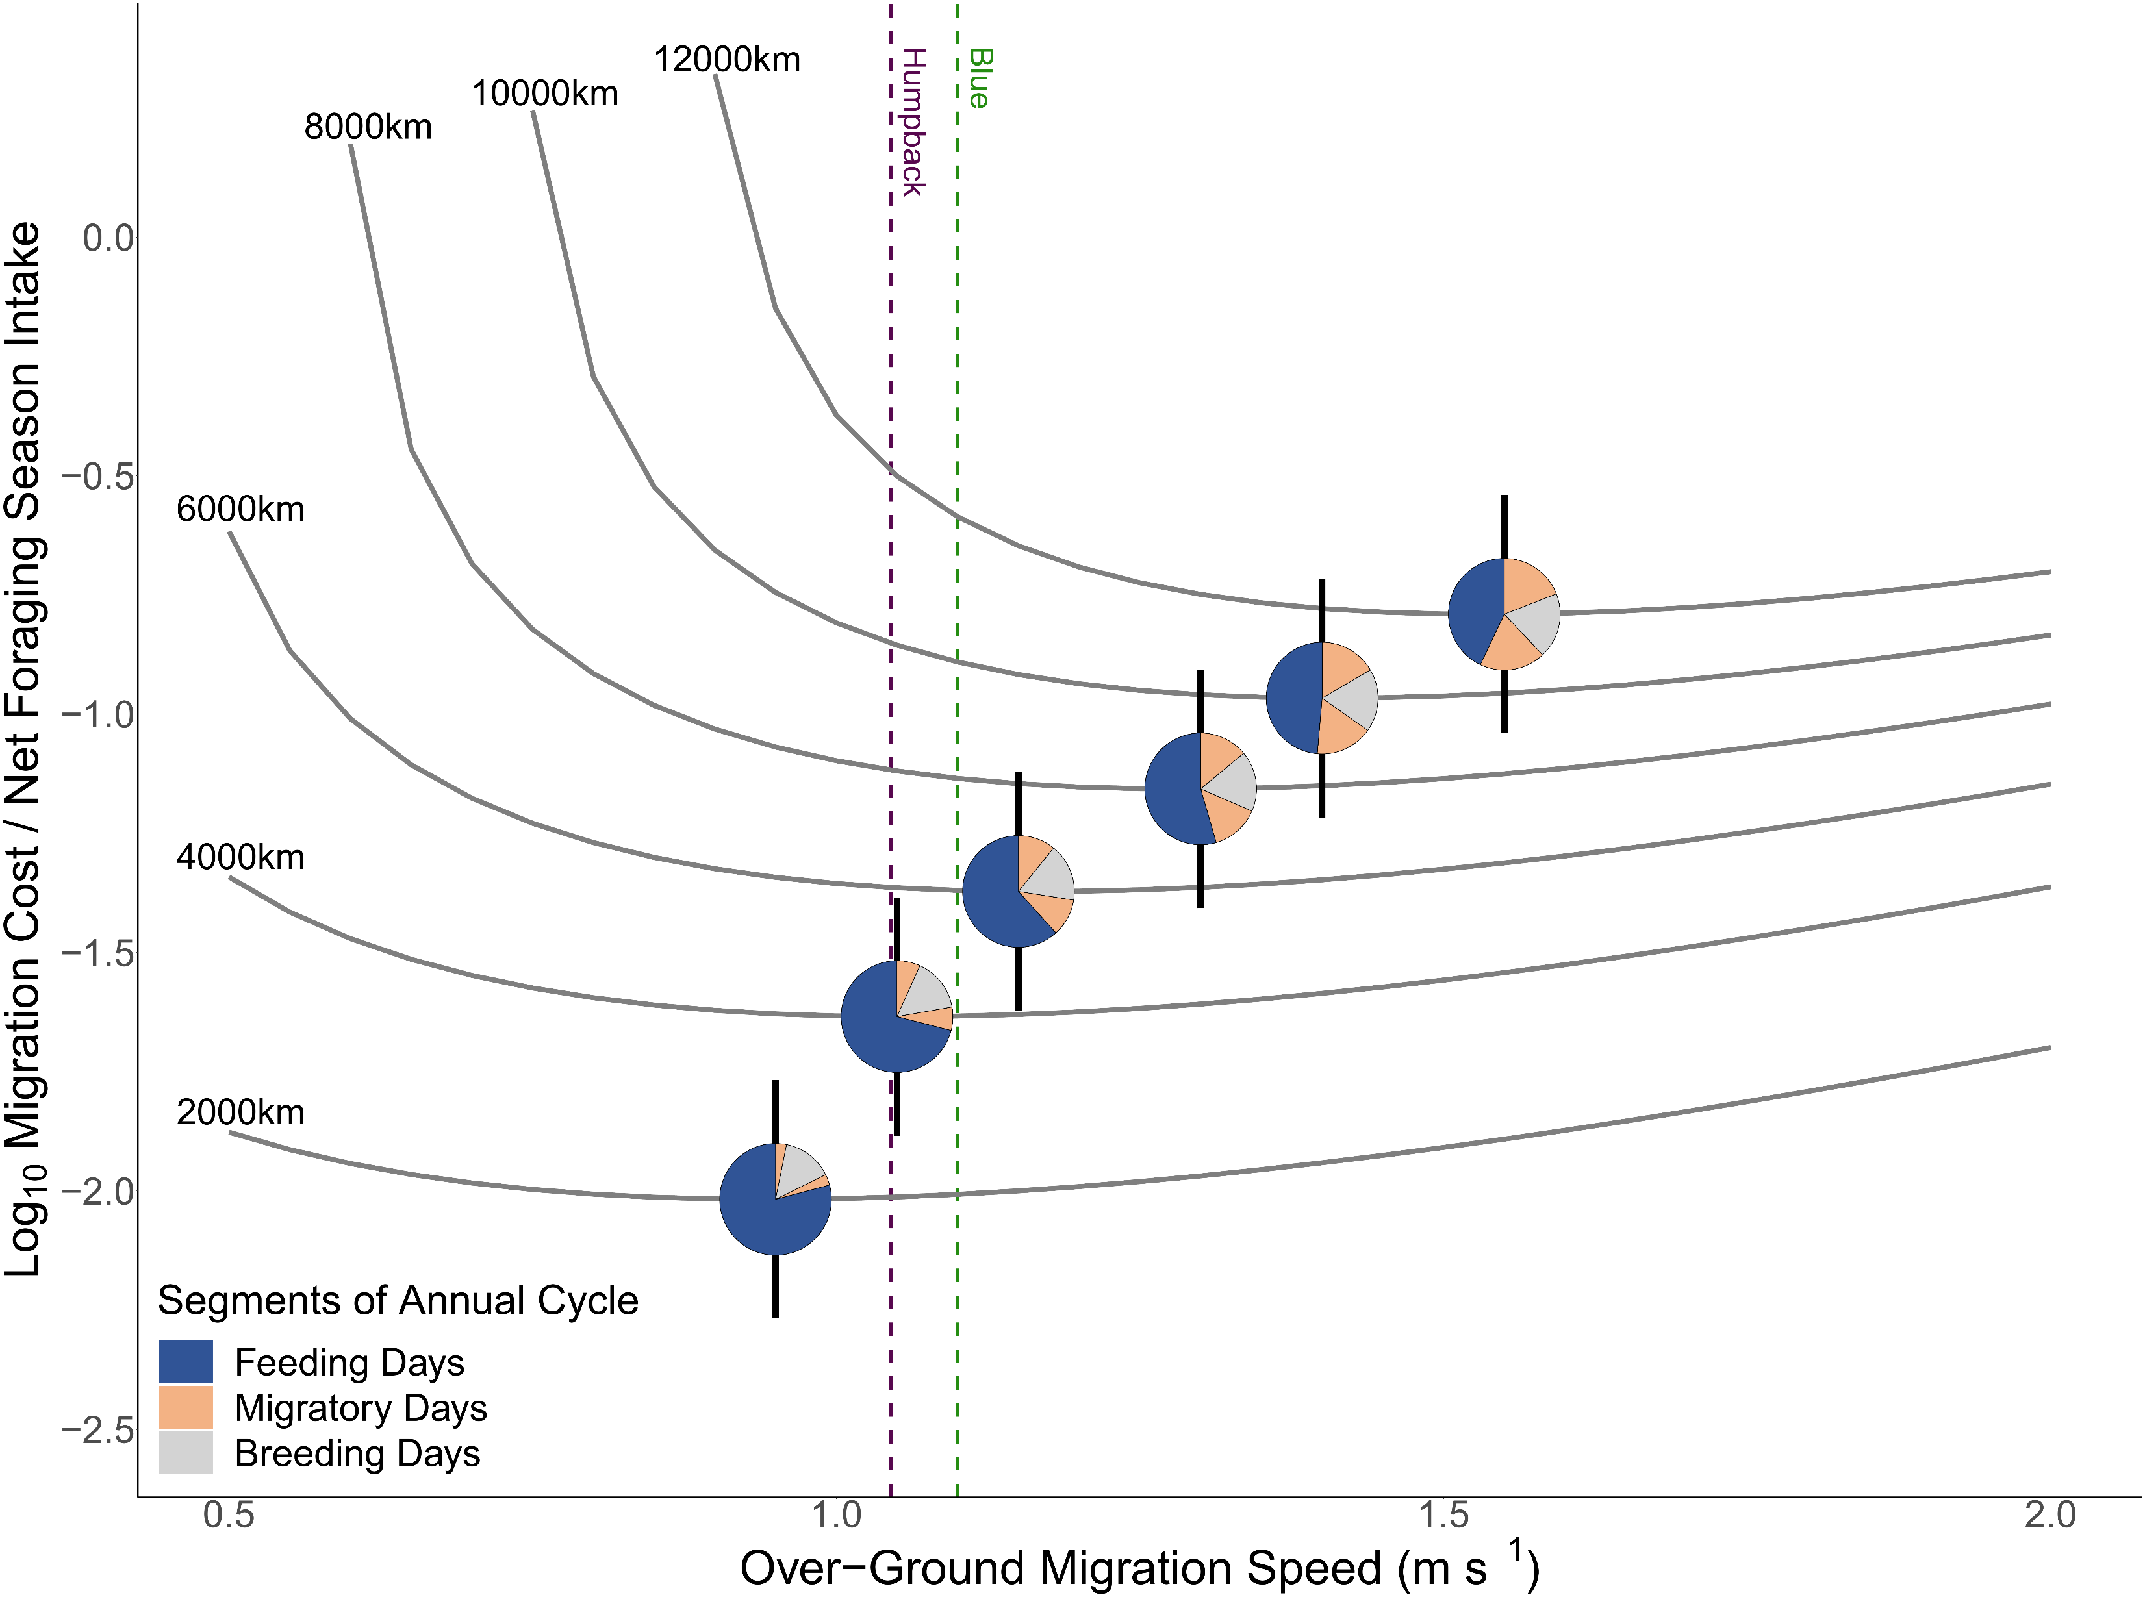

Slide 4
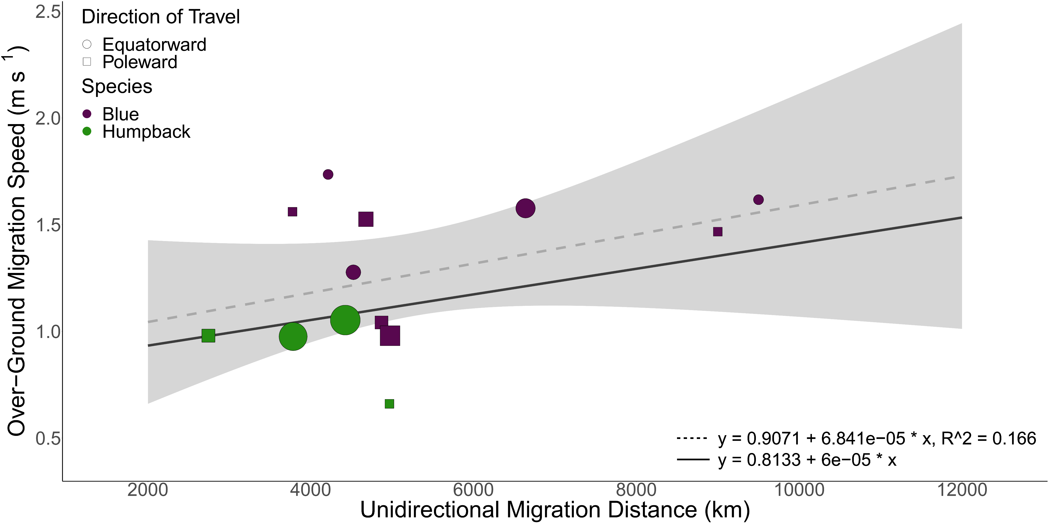

Slide 5
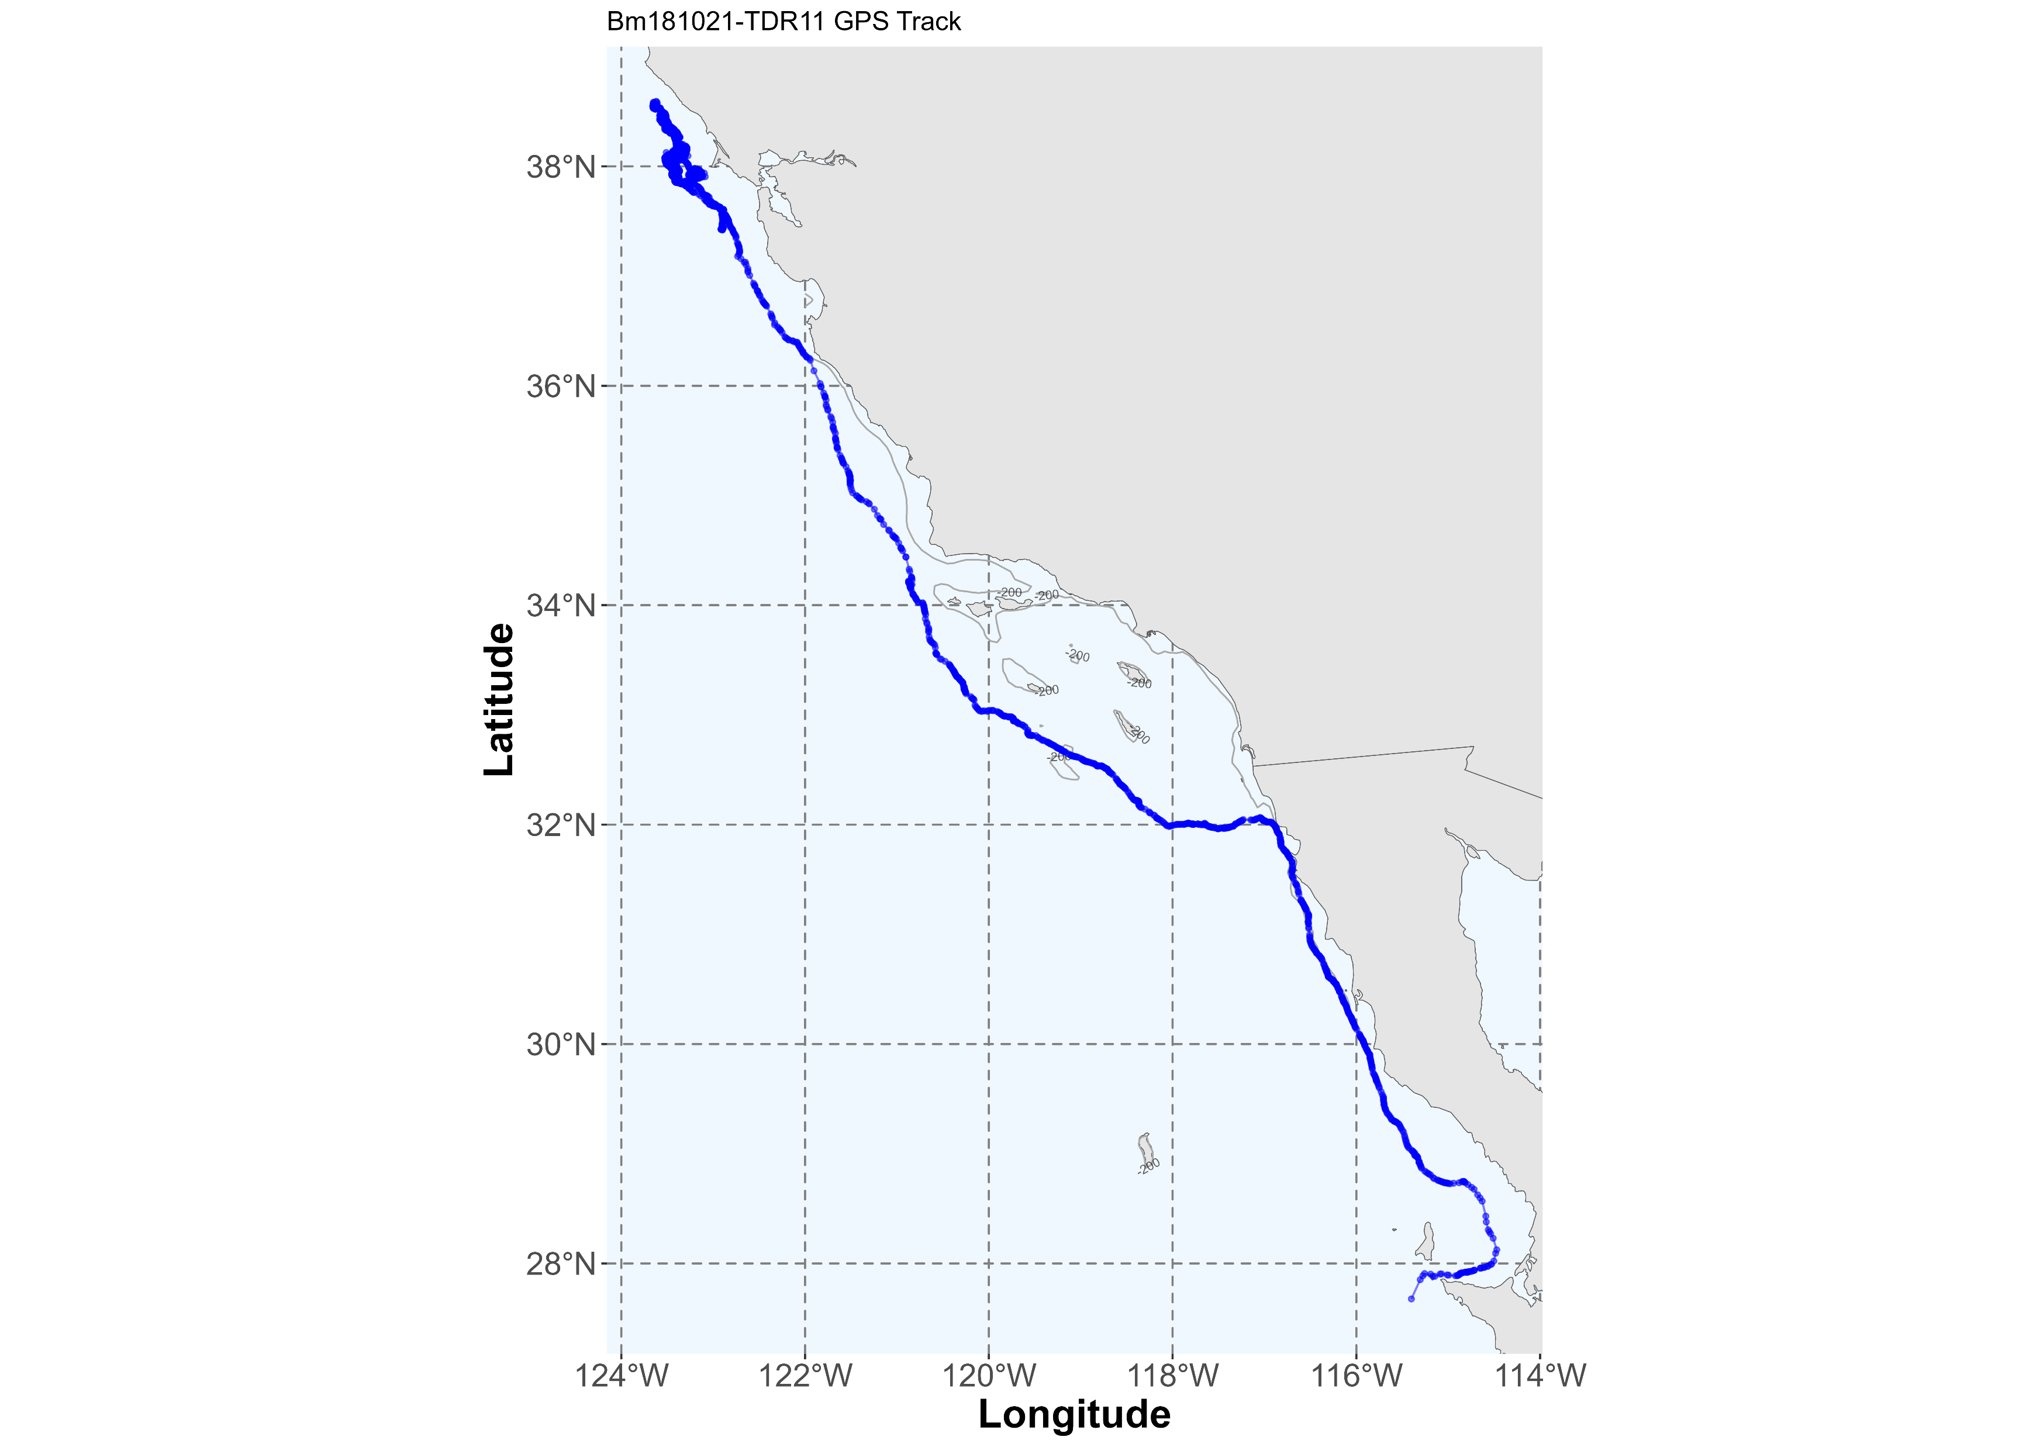
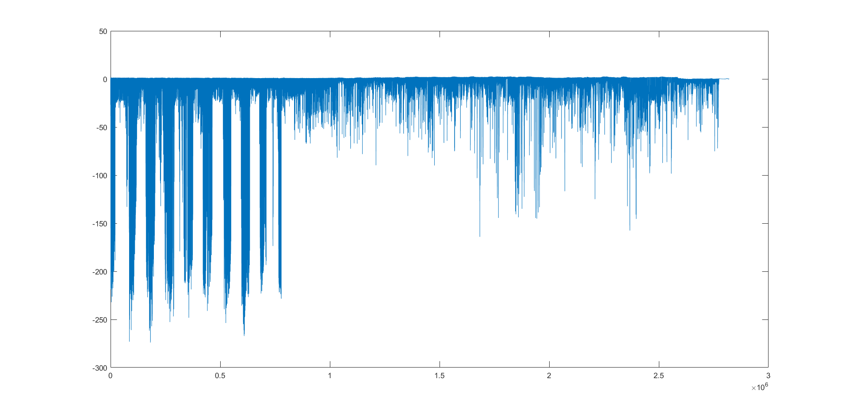
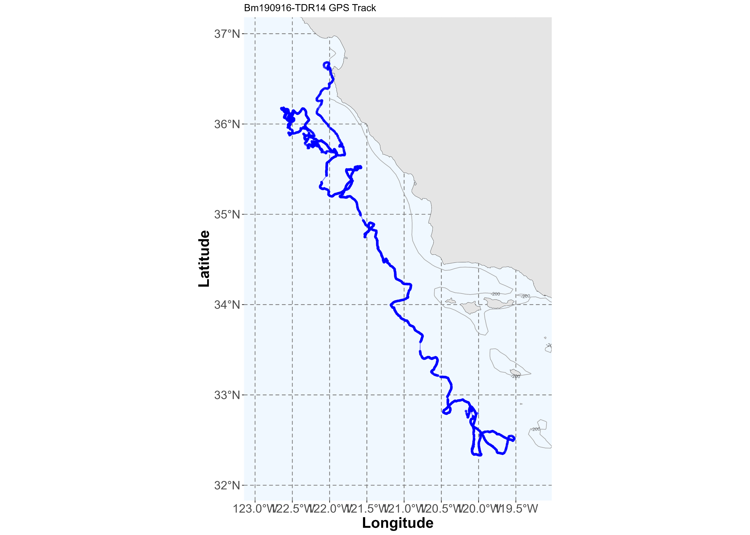
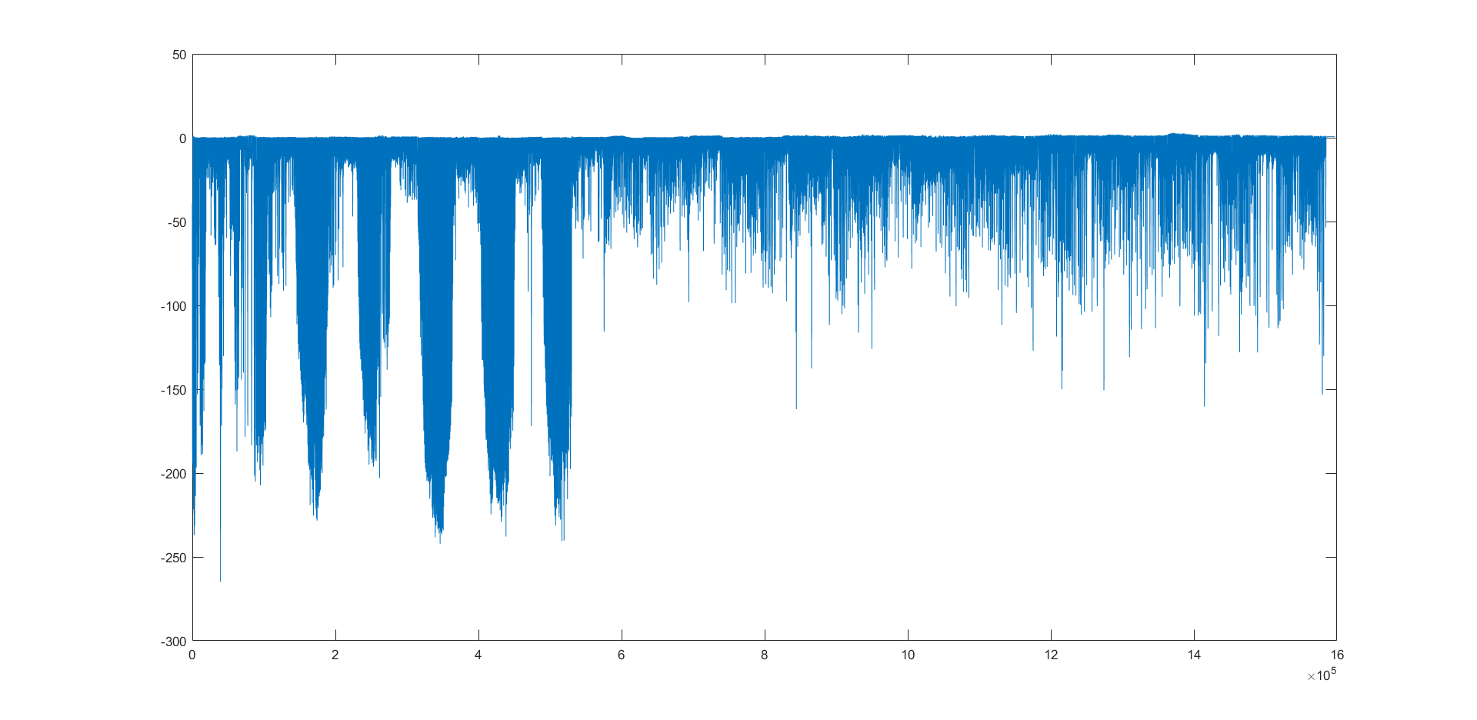

Slide 6
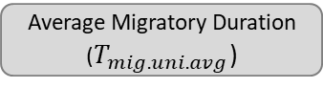
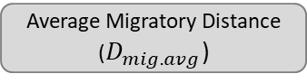
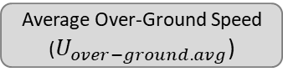
Satellite Tag Data
Multi-sensor Tag Data
Average Migratory Distance
($D_{mig.avg}$)
Eq. 1
Average Over-Ground Speed
($U_{over−ground.avg}$)
Average Migratory Duration
($T_{mig.uni.avg}$)
Stereotyped Annual Cycle

Slide 7
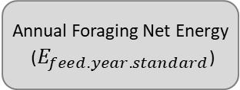
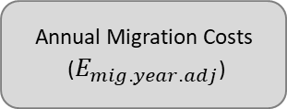
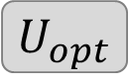
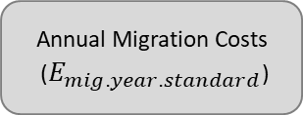
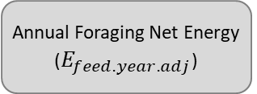
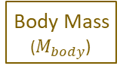
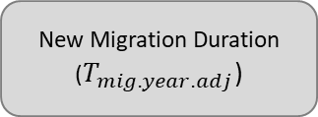
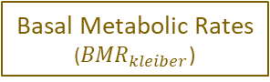
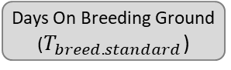
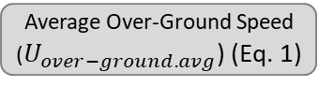
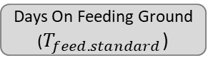
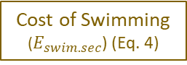
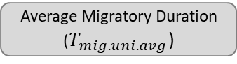
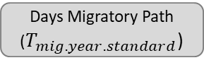
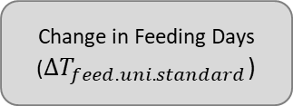
$$U_{opt}$$
Satellite Tag Data
Kahane-Rapport & Goldbogen, 2018
Migratory Distance Range
(4000 – 12000 km)
Average Migratory Distance
($D_{mig.avg}$)
Body Mass
($M_{body}$)
Potvin et al. 2021
Average Migratory Duration
($T_{mig.uni.avg}$)
Basal Metabolic Rates
(${BMR}_{kleiber}$)
Over-Ground Speed Range
(0.5 – 2.0 ms⁻¹)
Average Over-Ground Speed
($U_{over−ground.avg}$) (Eq. 1)
Cost of Swimming
($E_{swim.sec}$) (Eq. 4)
Eq. 7
Speed-Independent
Speed-Dependent
Annual Cycle
Energetic Calculations
Eq. 8
Annual Cycle
Energetic Calculations
Eq. 5
Days Migratory Path ($T_{mig.year.standard}$)
Eq. 6
Annual Migration Costs
($E_{mig.year.standard}$)
New Migration Duration ($T_{mig.year.adj}$)
Annual Migration Costs
($E_{mig.year.adj}$)
Days On Feeding Ground ($T_{feed.standard}$)
Eq. 3
Annual Foraging Net Energy
($E_{feed.year.standard}$)
Change in Feeding Days (${ΔT}_{feed.uni.standard}$)
Annual Foraging Net Energy
($E_{feed.year.adj}$)
Days On Breeding Ground ($T_{breed.standard}$)
Sightings Data;
Savoca et al. 2022
Gough et al. 2022 (Eq. 2)

Slide 8
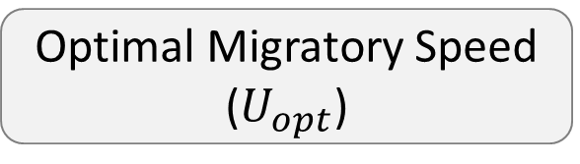
External Data Sources
Satellite Tag Data
Morphometrics
Sightings Data
Eq. 4
Stereotyped Annual Cycle
Cost of Swimming
Eq. 5
Speed-Dependent Annual Cycle
Optimal Migratory Speed
($U_{opt}$)

Slide 9
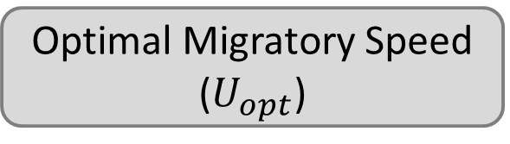
External Data Sources
Satellite Tag Data (Eq. 1)
Morphometrics
Multi-Sensor Tag Data
Fig. 2
Eqs 5, 6
Eq. 4
Eqs. 2, 3
Stereotyped Annual Cycle
Cost of Swimming
Speed-Dependent Annual Cycle
Eqs. 7 - 14
Optimal Migratory Speed
($U_{opt}$)
Eq. 15

Slide 10
External Data Sources
Satellite Tag Data
Multi-Sensor Tag Data
Morphometrics
Fig. 2; Eqs. 2 - 6
Speed-Independent
Stereotyped Annual Cycle
Eqs. 7 - 14
Speed-Dependent
Adjusted Annual Cycle
Eq. 15
Optimal Migratory Speed

